Slide 1

1. Understanding the Data

Slide 2
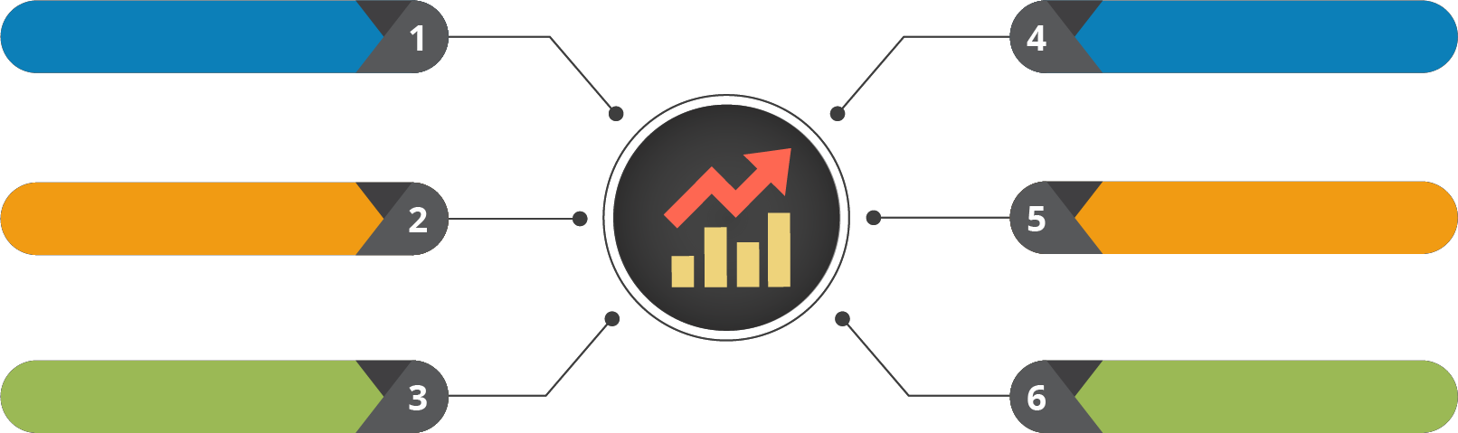


Course Outline
Introduction to Python
Functions, Modules & Packages
Understanding the Data
Testing the Data
Basics of Python
OOPs & Exception Handling
File Handling
Probability & it’s Usage
Data Clustering
String Manipulation
Numpy, Pandas, Matplotlib, SciPy
List Manipulation
Database
Statistical Inference
Regression Modelling
Tuple, Set Manipulation
Networking & Multithreading
Dictionaries Manipulation
Web Python

Slide 3

Course Objectives
After completing this module, you should be able to:
Understand Data Types, Variable Types
Define Population and Sample
Understand Sampling Technique
Represent Numerical data

Slide 4


1. Understanding the Data

Slide 5
What is Data?

Slide 6








What is Data?
Data in general terms refers to facts and statistics collected together for reference or analysis
Data is everywhere

Slide 7
Introduction to Data Types

Slide 8




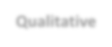


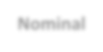





Data Types
Data
Qualitative
Quantitative
NNoommiinnaall
Ordinal
Discrete
Continuous

Slide 9
Qualitative Data

Slide 10


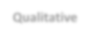




Qualitative Data
Data are measurements, each fall into one of several categories. (Hair color,
ethnic groups and other attributes of the population)
Qualitative
Nominal
Ordinal
Differentiating two groups
Grades are given to Students according to their performances

Slide 11


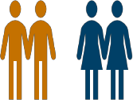
Nominal Data
Data with no inherent order or ranking such as gender or race, Such kind of data is called Nominal Data
Type 1
Male
Female
Female
Male
Male

Slide 12



Nominal Data - Example
#nominal data
ans1=input("Would you like to go for shopping? if yes then type Y / y else N/n") ans2=input("Do you love talking on any topic? if yes then type Y / y else N/n")
if(((ans1=='Y')|(ans1=='y'))&((ans2=='Y')|(ans2=='y'))):
print("Welcome to girls club")
else:
print("Sorry boys, you can not join the club")
Girls and Boys are differentiated based on the answers given by them

Slide 13




Ordinal Data
Data with an ordered series, such as shown in the table, Such kind of data is called Ordinal Data
Type 2
Customer’s id | Rating scale
101 | Strongly agree
302 | Disagree
013 | Neutral
001 | Agree
917 | Strongly disagree

Slide 14


Ordinal Data - Example
#Ordinal data
marks=int(input("Enter your percentage"))
if(marks<=40):
print("Fail")
elif((marks>40)&(marks<=50)): print("Second Class") elif((marks>50)&(marks<=60)):
print("First Class") elif(marks>=60):
print("Congratulations!! You got distinction")
Grades are given to students according to their score on the exam

Slide 15
Quantitative Data

Slide 16


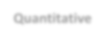





Quantitative Data
Data measured on a numerical scale (distance traveled to college, the number
of children in a family, etc.)
Quantitative
Discrete
Continuous
Children in Family, Students in Class
Amount of income tax paid

Slide 17


Discrete Data
Data which can be categorized into a classification, data which is based upon counts, there are only a finite number of values possible and the values cannot be subdivided meaningfully, Such kind of data is called Discrete Data
Organization | Number of Products
Samsung | 500
Apple | 30
Nokia | 10
LG | 450
Sony | 200

Slide 18


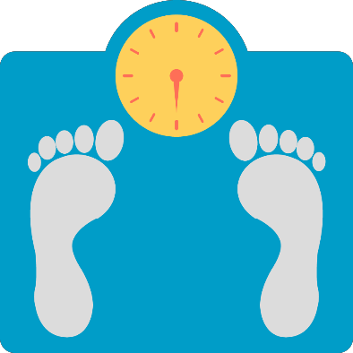
Continuous Data
Data which can be measured on a continuum or a scale, data which can have almost any
numeric value and can be subdivided into finer and finer increments
Such kind of data is called Continuous Data
Patient id | Weight of Patient
12 | 86.5 kg.
15 | 91.3 kg.
11 | 56.1 kg.
7 | 70.9 kg.
5 | 60.34 kg.

Slide 19
Variables

Slide 20












Variables
A Variable in algebra represents an unknown value or a value that varies
Variable
Categorial
Variable
Control
Variable
Independent
Variable
Confounding
Variable
Dependent
Variable

Slide 21















Variables (Contd.)
Categorial
Variable
Control
Variable
Confounding
Variable
Variables than can be put into categories. For example, male and female are two categories in a Gender
A factor in an experiment which must be held constant
Extra variables that have a hidden effect on your experimental results
Dependent
Variable
Independent
Variable
The outcome of an experiment
A variable that is not affected by anything

Slide 22




Experimental Research - Example
In Experimental Research, the aim is to manipulate an independent variable(s) and
then examine the effect that this change has on a dependent variable(s)
There are 100 students completing a math exam where the dependent variable was the exam mark and the independent variables were revision time and intelligence

Slide 23


Experimental Research - Example
IQ and Revision time
Exam Score
In such cases, it would be possible to use an experimental design and manipulate the revision time of the students

Slide 24




Experimental Research - Example
50 students
50 students
Group 1
Group 2
20 hrs revision
No revision
The tutor could divide the students into two groups. In "group one", the tutor could ask the students not to do any revision. Alternately, "group two" could be asked to do 20 hours of revision in the two weeks prior to the
test. The tutor could then compare the marks that the students achieved

Slide 25



Non-Experimental Research
Non-experimental research: In non-experimental research, the researcher does not manipulate the independent variable(s). This is not to say that it is impossible to do so, but it will be impractical
A researcher may be interested in the effect of illegal, recreational drug use (the independent variable(s)) on certain types of behaviour (the dependent variable(s))

Slide 26
Population and Sample

Slide 27

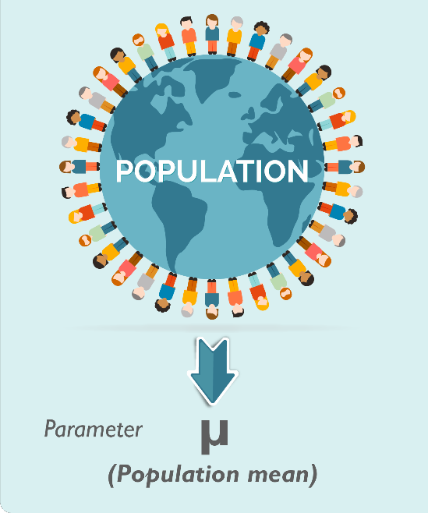
Population
A collection or set of individual or objects or events whose properties are to be analysed called as Population

Slide 28

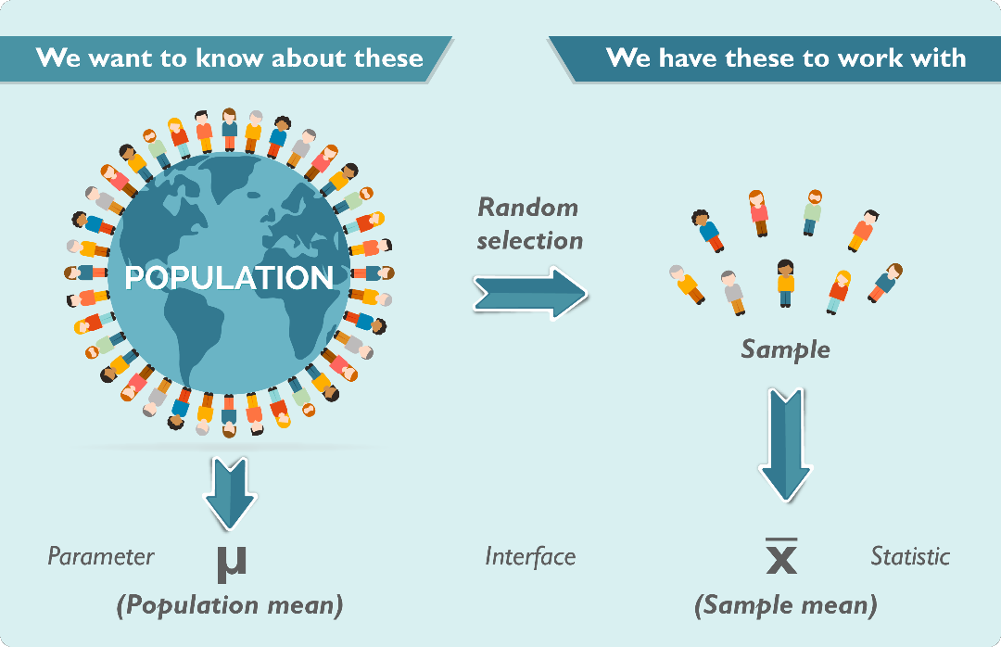
Sample
A subset of a population is called ‘Sample’. A well chosen sample will contain
most of the information about a particular population parameter

Slide 29
Sampling Technique

Slide 30


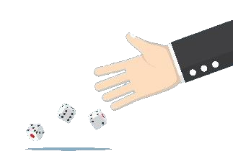



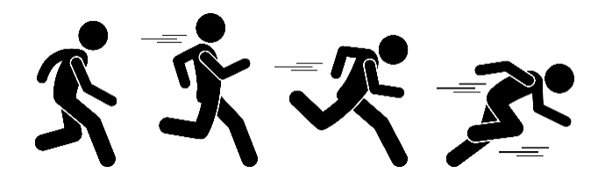

Sampling Technique
1. In Probability Sampling, each member of the population has a known non-zero probability of being selected
2. In Nonprobability Sampling, members are selected from the population in some non random manner

Slide 31
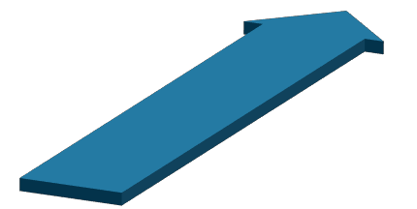
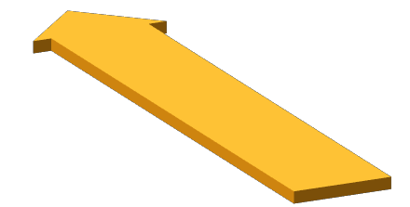

Probability Sampling
Systematic Sampling
Random Sampling
Stratified Sampling

Slide 32


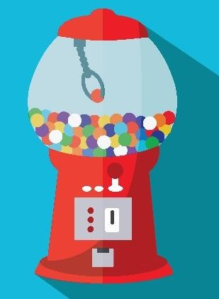

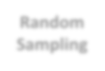








Probability Sampling
Random
Sampling
The Probability of each member of the population to be chosen has an equal chance of being selected
Systematic
Sampling
Random ball vending machine
Stratified Sampling
Such type of sampling is called Random Sampling

Slide 33

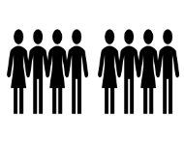



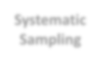


Probability Sampling
Random
Sampling
1
2
3
4
Every n^{th} record is chosen
2
4
6
8
5
66
7
8
2
Every 2nd record chosen
Systematic
Sampling
Systematic Sampling is often used instead of random sampling. It is also called an Nth name selection technique
After the required sample size has been calculated, every Nth record is selected
from a list of population members
Its only advantage over the random sampling technique is simplicity
Stratified Sampling

Slide 34


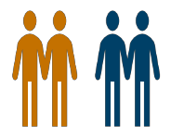



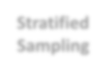
Probability Sampling
Random Sampling
Male subset
Random Sample chosen
Systematic
Sampling
Population
Female subset
Stratified Sampling commonly uses probability method that is superior to random sampling because it reduces sampling error
Stratified Sampling

Slide 35






Non-Probability Sampling
Snowball Sampling
.
04
Quota Sampling
03
Judgement Sampling
02
Convenience Sampling
01

Slide 36










Non-Probability Sampling
Convenience Sampling
Judgement Sampling
It is used in exploratory research where the researcher is interested in getting an inexpensive approximation of the truth
The researcher selects the sample based on judgment. This is usually and extension of convenience sampling
Quota Sampling
Snowball Sampling
It is the nonprobability equivalent of stratified sampling
It is a special nonprobability method used when the desired sample characteristic is rare

Slide 37
Descriptive Statistics

Slide 38


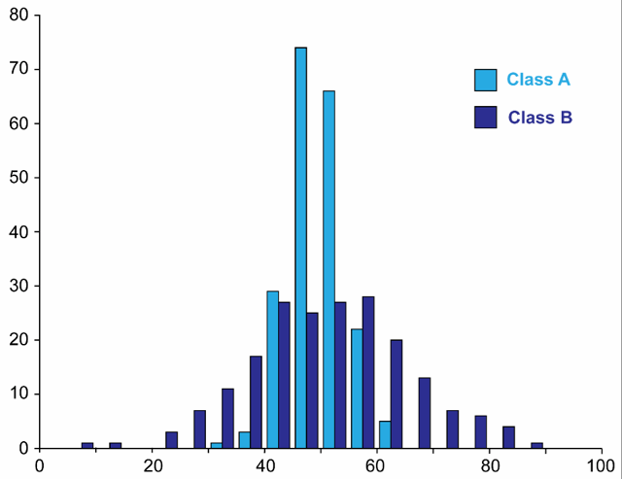

Descriptive Statistics
Descriptive Statistics is a data analysis
strategy
It deals with the presentation of numerical facts, or data, in either tables or graph form, and with the methodology of analysing the data
Example: A student's grade point average (GPA), provides a good understanding in analysing his overall performance
Descriptive Statistics primarily comprise of two major components: Measures of Center and Measures of Spread

Slide 39
Mean Median Mode

Slide 40



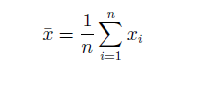

Mean
import pandas as pd
import numpy as np
x=[2,4,6,7,20,10,22]
y=np.array(x)
print("Mean is : ",y.mean())
The mean of set of numbers x1, x2, x3…..xN is defined as,

Slide 41



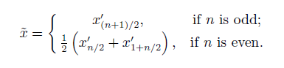

Median
import pandas as pd
import numpy as np
x=[2,4,6,7,20,10,22]
y=np.array(x)
print("Median is : ",np.median(y))
The statistical median of the data 𝑥_{𝑖} is defined as,

Slide 42


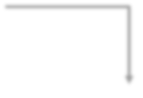


Mode
The statistical mode means the number which is repeated most of the time in the list
from statistics import mode
print("Mode is:",mode([1, 1, 2, 3, 3, 3, 3, 4]))

Slide 43
Use Case: Let’s Use Python to find Mean and Median of Values from a Dataset

Slide 44




Brain_size Analysis
A specific area survey has been done
The survey was related to IQ values, weight, height, MRI_count of all the citizens in that area
Categorization is done according to Gender

Slide 45





Finding Mean
If we want to find out average VIQ of Females among the population, we will check calculate the average of all the values
import pandas as pd
import numpy as np
data=pd.read_csv("brain_size.csv",sep=';',na_values='.') print(data.head())
print("\n") data1=data[data['Gender']=='Female']['VIQ'] print(data[data['Gender']=='Female'])
print("\n")
print("The mean value of Female VIQ is ", data1.mean())

Slide 46




Finding Median
If we want to find out the center value of VIQ of Females, we will order the VIQ values in
ascending order and choose the middle value

Slide 47




Finding Median
import pandas as pd
import numpy as np
data=pd.read_csv("brain_size.csv",sep=';',na_values='.') print(data.head())
print("\n")
data1=data[data['Gender']=='Female']['VIQ'] print(data[data['Gender']=='Female']) print("\n")
print("The mean value of Female VIQ is ", data1.mean())
print("\n")
VIQ = np.array(data1) print(VIQ) print("Mean VIQ:
", VIQ.mean())
print("Median VIQ ",np.median(VIQ)) print("Standard deviation:", VIQ.std())
print("Minimum VIQ:
print("Maximum VIQ:
", VIQ.min())
", VIQ.max())

Slide 48









Measure of Spread
A measure of spread, sometimes also called a measure of dispersion, is used to describe the variability in a sample or population
It is usually used in conjunction with a measure of central tendency, such as the mean or median, to provide an overall description of a set of data
Measures of Spread
Range
Inter-quartile Range
Variance
Standard Deviation

Slide 49
Range, Interquartile Range, Variance, Standard Déviation

Slide 50




Range
The range gives a measure of how spread apart the values are
The range is simply calculated as the maximum value – minimum value
Max(xi)–Min(xi)

Slide 51


Quartiles
Quartiles tell us about the spread of a data set by breaking the
data set into quarters, just like the median breaks it in half

Slide 52
Quartiles
Consider the marks of the 100 students below, ordered from the lowest to the highest scores
Order | Score | Order | Score | Order | Score | Order | Score | Order | Score
1st | 35 | 21st | 42 | 41st | 53 | 61st | 64 | 81st | 74
2nd | 37 | 22nd | 42 | 42nd | 53 | 62nd | 64 | 82nd | 74
3rd | 37 | 23rd | 44 | 43rd | 54 | 63rd | 65 | 83rd | 74
4th | 38 | 24th | 44 | 44th | 55 | 64th | 66 | 84th | 75
5th | 39 | 25th | 45 | 45th | 55 | 65th | 67 | 85th | 75
6th | 39 | 26th | 45 | 46th | 56 | 66th | 67 | 86th | 76
7th | 39 | 27th | 45 | 47th | 57 | 67th | 67 | 87th | 77
8th | 39 | 28th | 45 | 48th | 57 | 68th | 67 | 88th | 77
9th | 39 | 29th | 47 | 49th | 58 | 69th | 68 | 89th | 79
10th | 40 | 30th | 48 | 50th | 58 | 70th | 69 | 90th | 80
11th | 40 | 31st | 49 | 51st | 59 | 71st | 69 | 91st | 81
12th | 40 | 32nd | 49 | 52nd | 60 | 72nd | 69 | 92nd | 81
13th | 40 | 33rd | 49 | 53rd | 61 | 73rd | 70 | 93rd | 81
14th | 40 | 34th | 49 | 54th | 62 | 74th | 70 | 94th | 81
15th | 40 | 35th | 51 | 55th | 62 | 75th | 71 | 95th | 81
16th | 41 | 36th | 51 | 56th | 62 | 76th | 71 | 96th | 81
17th | 41 | 37th | 51 | 57th | 63 | 77th | 71 | 97th | 83
18th | 42 | 38th | 51 | 58th | 63 | 78th | 72 | 98th | 84
19th | 42 | 39th | 52 | 59th | 64 | 79th | 74 | 99th | 84
20th | 42 | 40th | 52 | 60th | 64 | 80th | 74 | 100th | 85
The first quartile (Q1) lies between the 25th and 26th. Q1 = (45 + 45) ÷ 2 = 45
The second quartile (Q2) between the 50th and 51st. Q2 = (58 + 59) ÷ 2 = 58.5
The third quartile (Q3) between the 75th and 76th. Q3 = (71 + 71) ÷ 2 = 71

Slide 53


Interquartile Range
The interquartile range (IQR) is a measure of variability, based on dividing a data set into quartiles
Quartiles divide a rank-ordered data set into four equal parts. The values that divide each part are called
the first, second, and third quartiles; and they are denoted by Q1, Q2, and Q3, respectively
The interquartile range is equal to Q3 minus Q1, ie. IQR = Q3 - Q1
Q1
Q2
Q3
25% | 25% | 25% | 25%
Interquartile Range

Slide 54


Deviation and Variance
Deviation - The difference between each xi, and the mean (for a sample, μ for a
population) is called a deviation about the mean
Variance - Is based on deviations and entails computing square of deviations
Population Variance - Average of squared deviations
Sample Variance - Sum of squared deviations divided by n-1
Population Variance
Sample Variance
𝛴 𝑥_{𝑖} − 𝜇
2
_{ҧ} 2
𝜎² =
෌ 𝑥 − 𝑥
𝑠² =
𝑖
𝑁
𝑛 − 1

Slide 55



Variance
Variance is a measurement of
the spread between numbers in a data set.
It measures how far each number in the
set is from the mean
Variance is calculated by taking the differences between each number in the
set and the mean, squaring the differences (to make them positive) and dividing the sum of the squares by the number of values in the set
x : Individual data points
n : Total number of data points
x̅ : Mean of data points

Slide 56



Standard Deviation
Standard deviation is a measure of the dispersion of a set of data from its mean. If the data points are
further from the mean, there is a higher deviation within the data set
Standard deviation is calculated as the square root of variance by determining the variation between each data point relative to the mean
x : Individual data points
n : Total number of data points x̅ : Mean of data points

Slide 57



Example
import numpy as np
from scipy import stats
import matplotlib
import matplotlib.pyplot as plt
%matplotlib inline matplotlib.style.use('ggplot')
np.random.seed(1)
data = np.round(np.random.normal(5, 2, 100)) plt.hist(data, bins=10, range=(0,10), edgecolor='black') plt.show()
mean = np.mean(data) print(mean)
print(np.median(data)) mode = stats.mode(data)
print("The modal value is {} with a count of{}".format(mode.mode[0], mode.count[0]))
Calculating Mean, Median and Mode

Slide 58



Example
Output of Calculation of Mean, Median and Mode
5.099999999996
5.0
The modal value is 5.0 with a count of 23

Slide 59









Calculating Range and Variance
print(np.ptp(data))
print(np.var(data))
Calculating Range
Calculating Variance
Output
9.0
3.0699999999998

Slide 60
Information Gain & Entropy

Slide 61





Information Gain and Entropy
Information Gain:
Information is a measure of facts
Information gain is the ratio of factual information, to uncertain information
It signifies a reduction in entropy or
uncertainty
where:
H(S) – entropy of the whole dataset S
|Sj| – number of instance with j value of an attribute A
|S| – total number of instances in dataset S
v – set of distinct values of an attribute A
H(Sj) – Entropy of subset of instances for attribute A
H(A, S) – entropy of an attribute A

Slide 62




Entropy
Entropy:
Entropy is a measure of uncertainty
We sometimes need to choose the options which have high information gain and low entropy while taking crucial decisions
Example: We are certain that flight is at 3 p.m., but uncertain regarding the exact time to reach the airport
Entropy H(S) can be calculated by using the formula:
where:
S – set of all instances in the dataset
N – number of distinct class values
pi – event probability

Slide 63
Use Case

Slide 64



Use Case
The match is going to be played on specific days. The task is to forecaster whether the match will be played or not according to weather conditions
Day | Outlook | Humidity | Wind | Play
D1 | Sunny | High | Weak | No
D2 | Sunny | High | Strong | No
D3 | Overcast | High | Weak | Yes
D4 | Rain | High | Weak | Yes
D5 | Rain | Normal | Weak | Yes
D6 | Rain | Normal | Strong | No
D7 | Overcast | Normal | Strong | Yes
D8 | Sunny | High | Weak | No
D9 | Sunny | Normal | Weak | Yes
D10 | Rain | Normal | Weak | Yes
D11 | Sunny | Normal | Strong | Yes
D12 | Overcast | High | Strong | Yes
D13 | Overcast | Normal | Weak | Yes
D14 | Rain | High | Strong | No

Slide 65


Use Case - Solution
We are going to use Decision Tree to find the solution for this situation
9 Yes / 5 No
Outlook
Sunny
Overcast
Rain
Day | Outlook | Humidity | Wind
D1 | Sunny | High | Weak
D2 | Sunny | High | Strong
D8 | Sunny | High | Weak
D9 | Sunny | Normal | Weak
D11 | Sunny | Normal | Strong
Day | Outlook | Humidity | Wind
D3 | Overcast | High | Weak
D7 | Overcast | Normal | Strong
D12 | Overcast | High | Strong
D13 | Overcast | Normal | Weak
Day | Outlook | Humidity | Wind
D4 | Rain | High | Weak
D5 | Rain | Normal | Weak
D6 | Rain | Normal | Strong
D10 | Rain | Normal | Weak
D14 | Rain | High | Strong
P s bs
Yes(will play)
2 Yes / 3 No
3 Yes / 2 No
Split further
Split further

Slide 66


Use Case - Solution
Dataset entropy
From the total of 14 instances we have:
9 instances “yes”
5 instances “no”

Slide 67






Use Case - Solution
Which attribute to select?

Slide 68




Use Case - Solution
Information Gain of attribute “windy”
Windy
Weak
Strong
From the total of 14 instances we have:
6 instances “Strong”
8 instances “Weak”
yes yes yes yes yes yes no no
yes yes yes no no no

Slide 69




Use Case - Solution
Information Gain of attribute “outlook”
outlook
Sunny
Rainy
From the total of 14 instances we have:
Overcast
5 instances “sunny”
4 instances “overcast”
5 instances “rainy”
yes yes no no no
yes yes yes no no
yes yes yes yes

Slide 70




Use Case - Solution
Information Gain of attribute “humidity”
Humidity
high
normal
From the total of 14 instances we have:
7 instances “high”
7 instances “normal”
yes yes yes no no no no
yes yes yes yes yes yes no

Slide 71




Use Case - Solution
Information Gain of attribute “temperature”
temperature
hot
cool
From the total of 14 instances we have:
mild
yes yes yes Yes no no
4 instances “hot”
6 instances “mild”
4 instances “cool”
yes yes no no
yes yes yes no

Slide 72


Use Case - Solution
Which attribute to select?
0.247
0.048
0.151
0.029

Slide 73
Confusion Matrix

Slide 74

What is a Confusion Matrix?
A Confusion Matrix is a table that is often used to describe the performance of a classification model (or "classifier") on a set of test data for which the true values are known
Confusion Matrix represents a tabular representation of Actual vs Predicted values
You can calculate the accuracy of your model with:
True Positives + True Negatives
True Positives + True Negatives + False Positives + False Negatives

Slide 75





Confusion Matrix - Example
There are two possible predicted classes: "yes" and "no”
The classifier made a total of 165 predictions
Out of those 165 cases, the classifier predicted "yes" 110 times, and "no" 55 times
In reality, 105 patients in the sample have the disease, and 60 patients do not

Slide 76





Confusion Matrix - Example
True Positives (TP): These are cases in which we predicted yes (they have the disease), and they do have the disease
True Negatives (TN): We predicted no, and they don't have the disease
False Positives (FP): We predicted yes, but they don't actually have the disease. (Also known as a "Type I error.")
False Negatives (FN): We predicted no, but they actually do have the disease. (Also known as a "Type II error.")

Slide 77
Sensitivity and Specificity

Slide 78

Confusion Matrix - Values

Slide 79





Sensitivity
Sensitivity (also called the true positive rate, the recall, or probability of detection in some fields) measures the proportion of positives that are correctly identified
In probability notation,
Sensitivity = True positive / (True Positive + False Negative)
Sensitivity= 100
(100+5)
= 0.95
The fraction of all those with the
disease who get a positive test result

Slide 80



Specificity
Specificity (also called the true negative rate) measures the proportion of negatives that are correctly identified as such (e.g. the percentage of healthy people who are correctly identified as not having the condition)
In probability notation,
Specificity = True Negative / (
True Negative + False Positive )
Specificity= 50
(50+10)
= 0.8333
The fraction of those without the
disease who gets a negative test result

Slide 81

Summary
In this module, you should have learnt:
Understand Data Types, Variable Types
Define Population and Sample
Understand Sampling Technique
Represent Numerical data

Slide 82


Congratulation
Probability & Statistics
for Data Science
You have successfully completed –
Understanding the Data Session

Slide 83





Next Topic, We will see the
Probability
Okay, I clearly understand the Data
What Next?

Slide 84



Slide 86


Slide 87


Slide 88


